Slide 1


AutoFocus of Drosophila Melanogaster Embryos Using Gabor Filters for RoboCam
Tom Zimmerman, Jiayu Luo
IBM Research, SFSU
4.30.23
This material is based upon work supported by the NSF under Grant No. DBI-1548297.
Disclaimer: Any opinions, findings and conclusions or recommendations expressed in this material are those of the authors and do not necessarily reflect the views of the National Science Foundation.

Slide 2
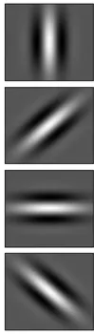
Gabor Filter
0
45
90
135
Its impulse response is defined by a sinusoidal wave (a plane wave for 2D Gabor filters) multiplied by a Gaussian function. Because of the multiplication-convolution property (Convolution theorem), the Fourier transform of a Gabor filter's impulse response is the convolution of the Fourier transform of the harmonic function (sinusoidal function) and the Fourier transform of the Gaussian function

Slide 3
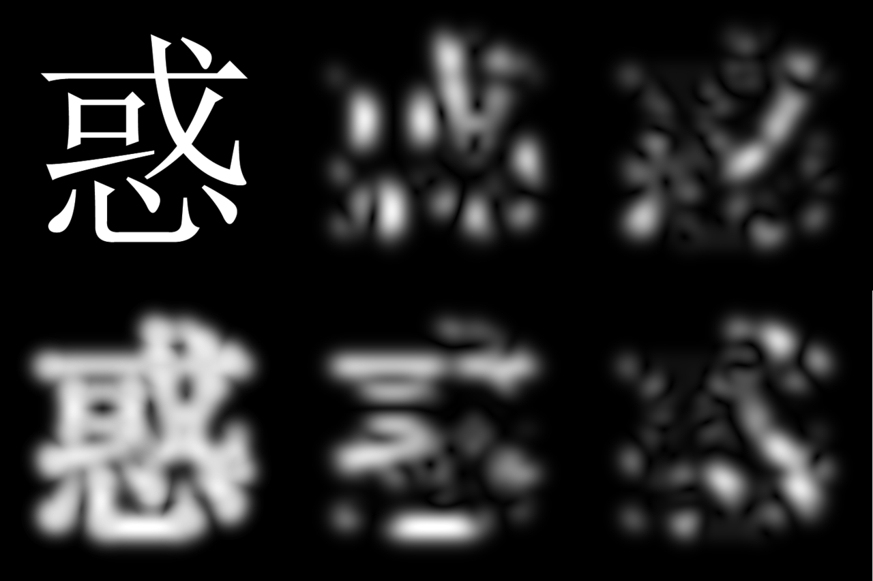
Original Image Gabor Filter Outputs
0 45
90 135
Combined Filter Output

Slide 4
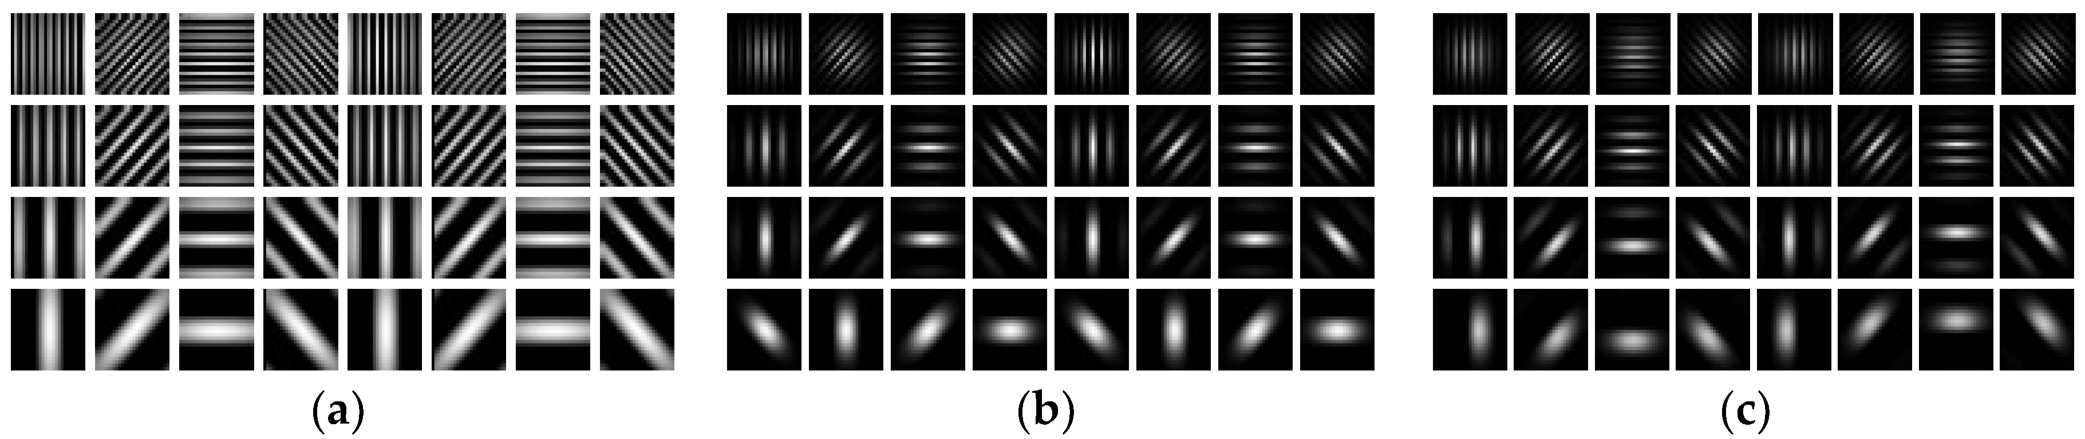
0 45 90 135
0 45 90 135
7f
5f
3f
f

Slide 5
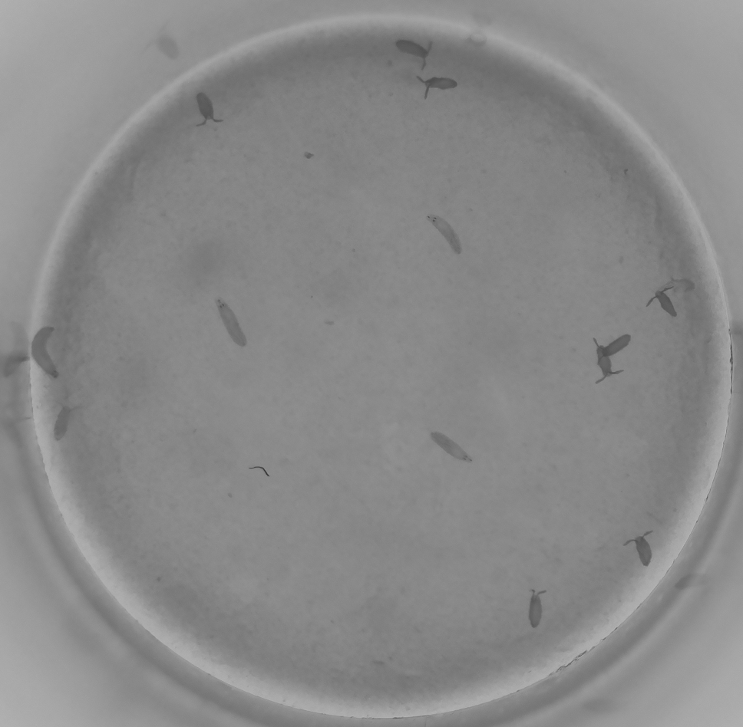
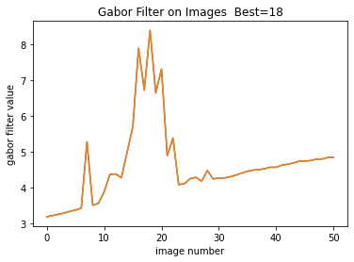
Gabor Filter Kernel Settings
theta = 0, 90
angle = theta / 4. * np.pi
sigma= 1
frequency=0.35
kernel = np.real(gabor_kernel(frequency, theta=angle,sigma_x=sigma, sigma_y=sigma))
F5 #18
Combined
0 and 90 filter output

Slide 6
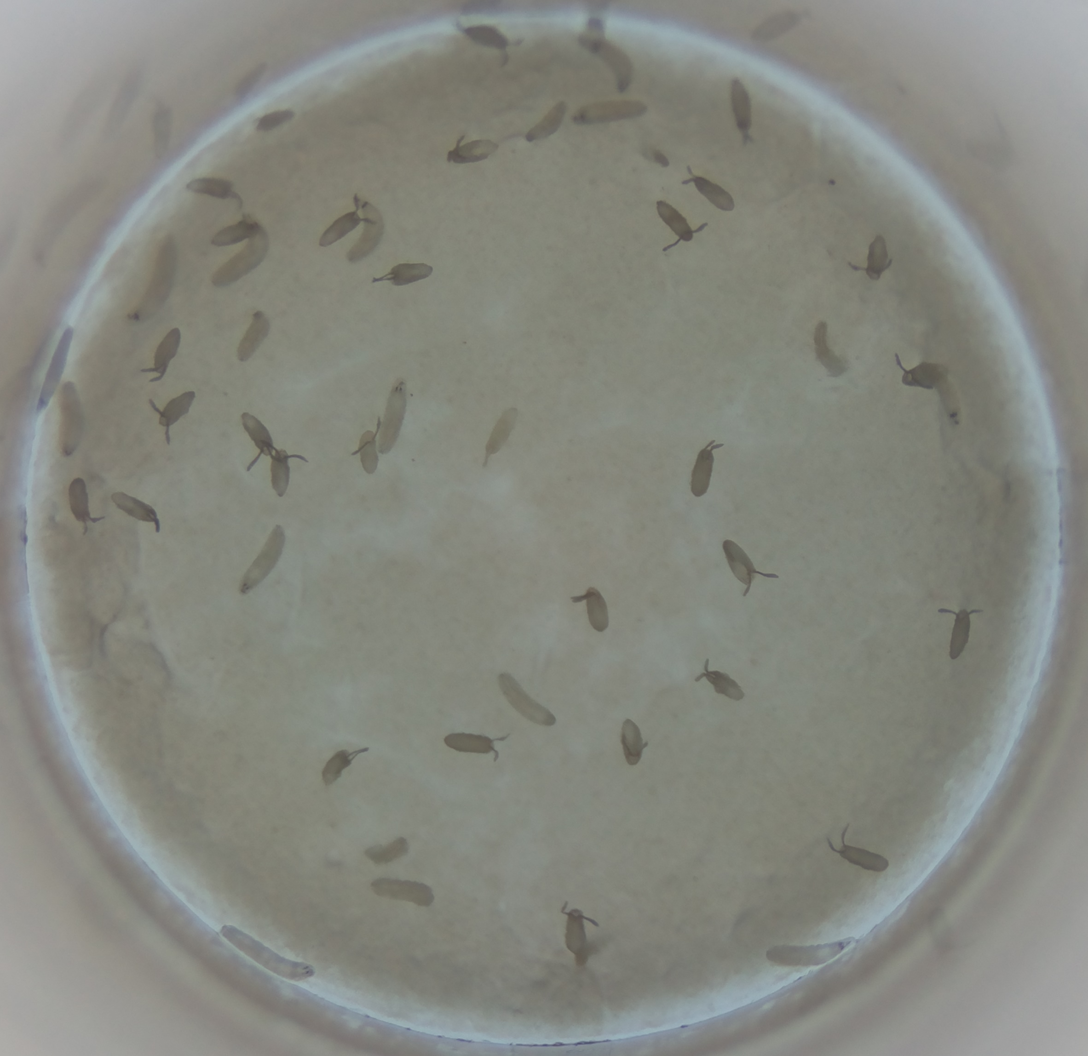
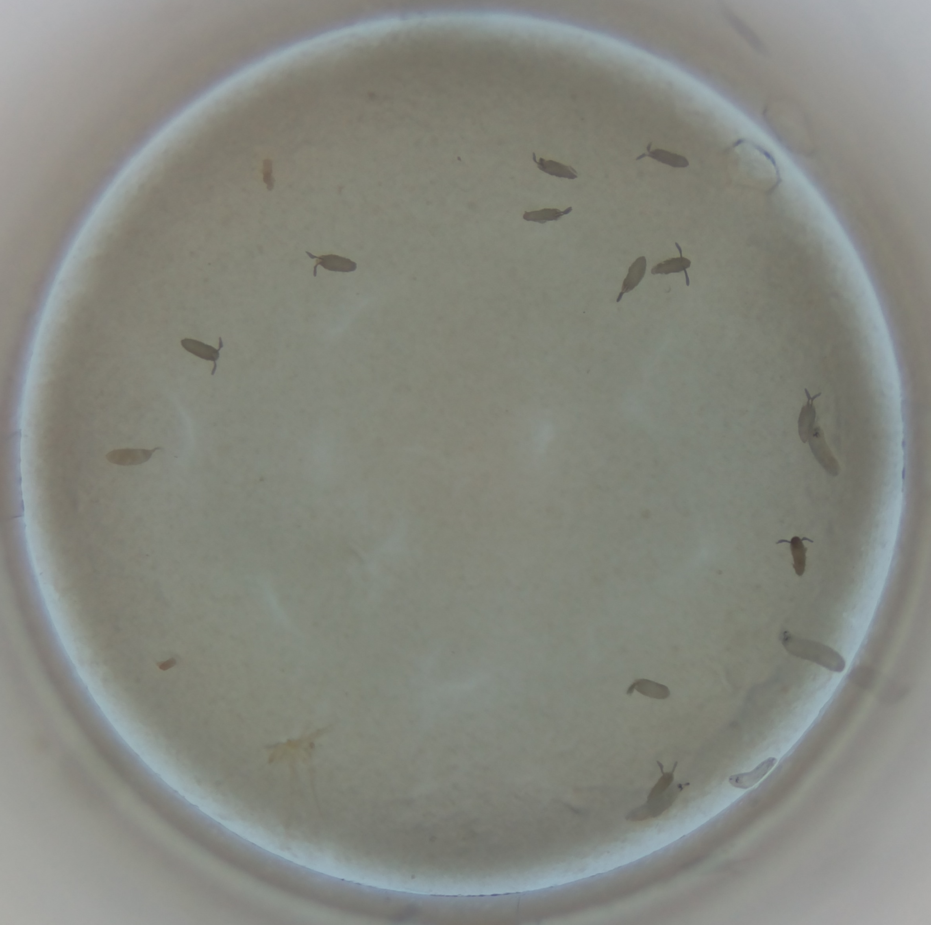
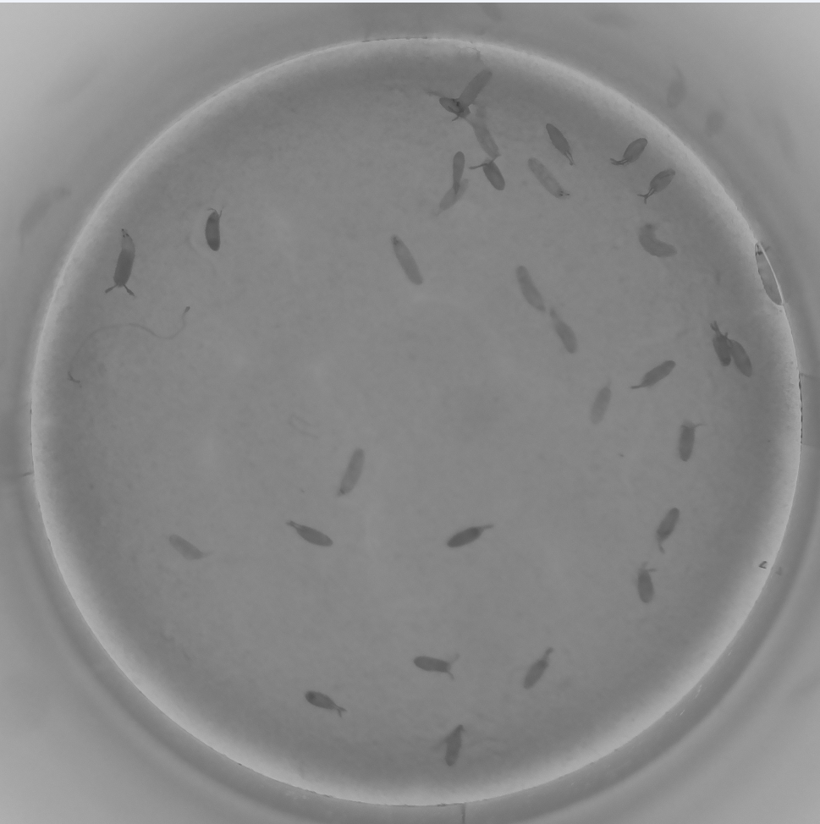
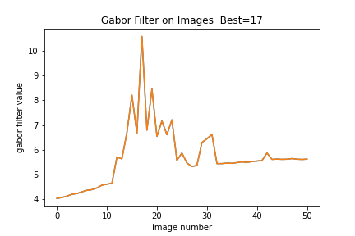
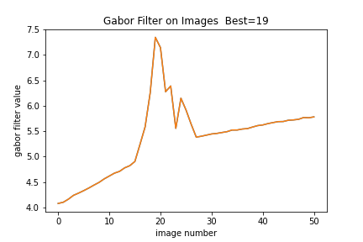
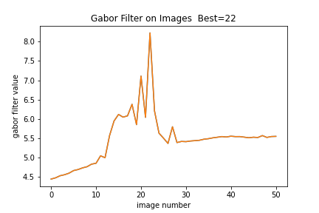
C5 #17 D4 #19 E2 #22

